Slide 1
Sarah’s Family Immigration
Grade 5
Ms Booth’s Class

Slide 2
Great Granny Jill
I chose to find out about my GGranny Jill Mobbs because my mom knew the answers to most of the questions.
Jill Mobbs was born in Devonport England in 1911. She was an only child and lived there until she was 10.
In 1921 She moved to Canada with her parents. They settled in Edmonton Alberta because her father found a job there as a butcher.

Slide 3
Push & Pull factors
Push
Her family wanted to avoid living through another possible war.
Her father was finding it hard to find work being a butcher in England.
Pull
Canada wqs advertising land and jobs for anyone who would move.
They could own their own house on a farm in Canada.
Edmonton needed butchers so her dad was promised a good job.

Slide 4
Hardships – Arriving in Canada
Winter
Edmonton was much colder than they expected. Her dad got frost bite and had to get 2 toes amputated.
She had to stay home and in the house for months. She was lonely, being an only child.
Food Shortages
There was a boom of immigration to Edmonton but not enough time to properly grow food for them all. They had to live off of what they could find in the environment.
Medical
GGranny Jill had asthma and at the time, there wasn’t as much knowledge about it and the treatments. The cold winters made it worse for her.
There was only one doctor in the town she lived in. It was expensive to see a doctor.

Slide 5
Opportunities in Canada
Work
Her dad was the only butcher in the town. He had a lot of clients and made good money.
He was able to own his own business and eventually expand to other communities.
Food
There was a lot of hunting and trapping at this time so her father always had access to meat for the family.
He was able to trade meat for vegetables so after the 2nd year of living in Edmonton, they always had enough to eat.
Culture
My GGranny Jill was very happy to meet a lot of different people in Canada. Some of her closest friends came from different parts of Europe.
Her dad worked closely with First Nations groups so she was able to join him for special ceremonies. She had a lot of beautiful piece of art because of it.
They could afford a nice house and lots of land to eventually have goats, sheep and pigs on.

Slide 6
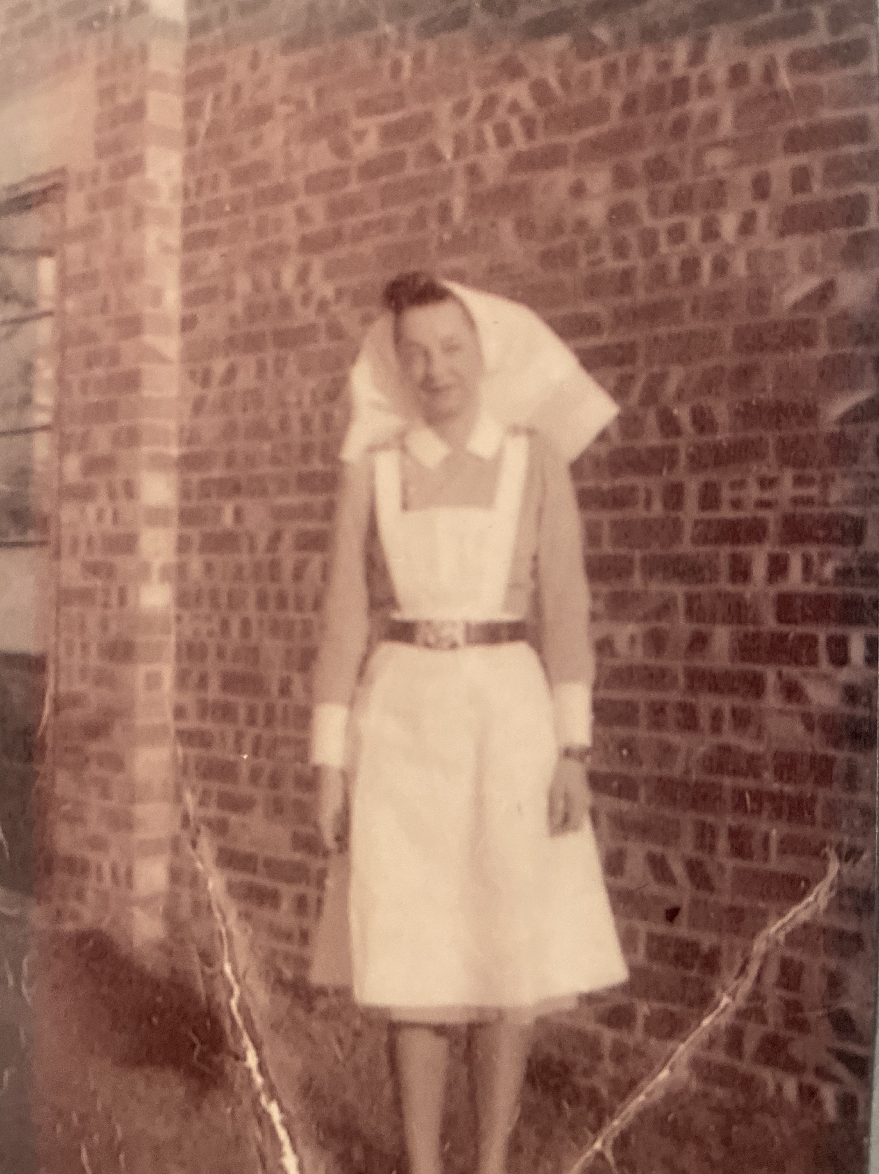
Interesting Facts
She got a good education in Canada and became a nurse
She ended up joining the Canadian Army as a nurse and was in England during WW 2
She met my GGrandpa James during the war and he was from British Columbia.

